Slide 1
Fourth (or fifth) Mentor Demo
Norbert Szücs
Pallida Cohort - Static Class

Slide 2
STM32F7 Discovery board Basics
Complete demonstration and development platform
Full range of hardware features
Offers everything to get started quickly
Notes:
STM32f7 discovery board is a complete demonstration and development platform for ARM Cortex M7 core-based microcontroller. The full range of hardware features on the board helps users to evaluate almost all peripherals. And it has a lot. It also offers everything required for users to get started quickly and develop applications easily.

Slide 3
STM32F7 Discovery board System requirements
Windows® OS (XP, 7, 8 and 10), Linux® 64-bit or macOS™
USB Type-B to Micro-AB cable

Slide 4
STM32F7 Discovery board Features
USB OTG
10/100-Mbit Ethernet
microSD card slot
Audio DAC
4.3-inch color LCD-TFT with capacitive multi-touch panel
And many more
Notes:
OTG means On The Go and it allows a direct connection with othe USB devices without the need for a host computer
Audi DAC means Digital to Analog Converter. It comes with a 3.5 mm jack output and 2 audio analog to digital converters.

Slide 5
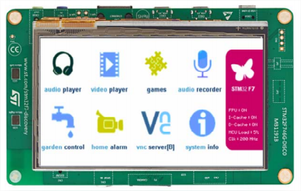
STM32F7 Discovery board What does it stand for

Slide 6
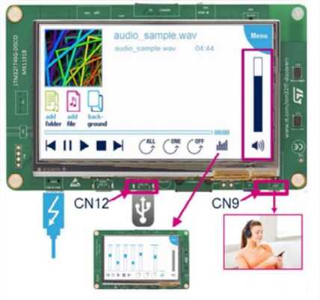
STM32F7 Discovery board What does it stand for

Slide 7
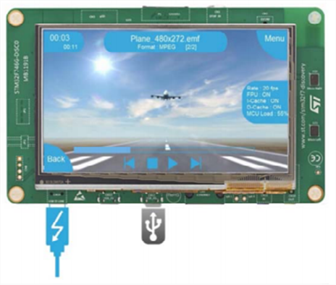
STM32F7 Discovery board What does it stand for

Slide 8
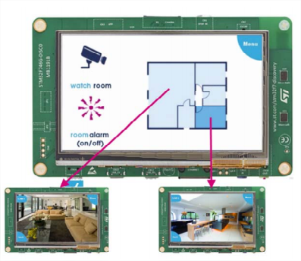
STM32F7 Discovery board What does it stand for

Slide 9
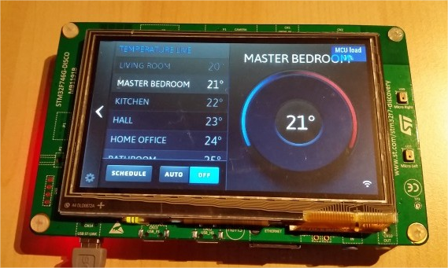
STM32F7 Discovery board What does it stand for

Slide 10
Thank you for your attention!

